Slide 1
District Assembly Workshop
Topic: International Service & Foundation
Facilitators: David Alexander, District Rotary Foundation Chair
Tony Stokes, District International Service Chair
Notes:
Welcome / Introductions:
DGE Ian Ballantine; DGN Colin Byron; DG Ken Miller
District Foundation Chair, David Alexander
District International Service Chair, Tony Stokes.
Kylie Knight-Brown hosting
Some Housekeeping:
Mute unless speaking to the meeting (background noise)
Hand up icon (reactions) to speak or use chat function – Kylie will monitor.
Session being recorded

Slide 2
Learning Objectives:
By the end of the session attendees will:
Have an understanding of the role of the Rotary Foundation & International Service Chairs in your club in identifying and stewarding projects.
Understand the basics of The Rotary Foundation & Foundation Grants
Know where to go for more help or information

Slide 3
International Service Segment

Slide 4
Why Support International Projects?
Global Reach
Great Need
Close to Home
Connections
Economical
Foundation
Expert Advice
Notes:
Those who were at this session last year may remember this slide showing 7 good reasons for clubs to be supporting International projects.
This year, I am just going to focus on one particular aspect…..

Slide 5
Great Need
CLIMATE CHANGE
Notes:
International service exemplifies Rotary’s global reach in promoting peace and understanding through a range of projects which help address the great need in the world today caused by poverty, lack of education, climate change, natural disasters and the pandemic among other reasons.
These in turn are major contributing factors to conflicts over food insecurity, access to clean water, land for grazing and agriculture and tribal and national interests.
It is significant that these factors form the majority of the UN’s Sustainable Development Goals.

Slide 6
What are International Projects?
And many more, including International District Grants & Global Grants!
See on the District website at https://www.9810rotary.org.au/page/international-service
Rotary Showcase for Project Ideas
https://map.rotary.org/en/project/pages/project_showcase.aspx
Notes:
And you don’t have to start with a Global Foundation Grant; here are some International projects you can consider supporting right now. They are all important components of Rotary addressing need and “doing good in the world”.
There are other options listed on the District website which you can consider as a way to get started in International Service. Even Polio and Youth Exchange can be considered International projects.
However, we are keen to see clubs designing and implementing projects based on an identified need and with or without TRF matching. The Rotary Showcase on the RI website is a good source of project ideas or talk to David or me – we may be able to help.

Slide 7
International Service Involvement
District 9810 International Survey 2022
Baseline 2021-2022
18 Clubs a
3 Clubs r
1 Club ?
Planned 2022-2023
18 Clubs a
1 Club r
3 Clubs ?
Notes:
This slide from the District 9810 International Service Survey conducted last year shows the level of activity of clubs in this type of work over the last 2 years.
However, the majority of the clubs who indicated they were involved in international service in fact were donating to the established programs with only 5 saying they had supported or participated in an International Global Grant. And there were only 2 International Global Grants and 1 International District Grant approved in D9810 in 2022-2023.
So one message we are asking you to take back to your clubs is please seriously consider undertaking a major International Project for 2023-2024.
I will now hand over to David to introduce the next segment on The Rotary Foundation (UNSHARE SCREEN)

Slide 8
Foundation Segment

Slide 9
Our D9810 2023/24 Foundation Team
Your Rotary Club
Your Rotarians!
Our focus – is your success!
David Alexander Chair
John Barnes Giving, Paul Harris Society; Bequests
Graham Richardson Grants
Gus Rozycki Grants Modernization
David Grieve Polio
Ian Donald Centurion
Andrew Brownlie Stewardship
Kehela Vandenberg Alumni
Dr Jane Mulcahy Peace Scholars / Scholarships
Rotaract Invitee Project Liaison
Tony Stokes District Resource Network

Slide 10
Foundation Presentations
What Club Foundation Chairs - need to know in 2023-24
Speakers
John Barnes Giving
Graham Richardson Grants
Andrew Brownlie Stewardship
David Alexander Supporting Programs

Slide 11
Giving to The Rotary Foundation
John Barnes
(PDG – Past Zone Foundation Coordinator)
Notes:
The aim of this session is to give you an awareness of what has to be done, and when, if you want to use funding from The Rotary Foundation to support your projects. We are NOT going to talk much about the planning and implementation of grant projects, - that is the role of the Grants Qualification & Management seminar that’s usually held in May. So this talk will cover the action needed to plan for and obtain grant funding for next Rotary year – and particularly for District Grants.
As you probably know, … [Click]

Slide 12
Rotary Foundation Grant Projects
Graham Richardson
(PP - District Grants Sub Committee)
Notes:
The aim of this session is to give you an awareness of what has to be done, and when, if you want to use funding from The Rotary Foundation to support your projects. We are NOT going to talk much about the planning and implementation of grant projects, - that is the role of the Grants Qualification & Management seminar that’s usually held in May. So this talk will cover the action needed to plan for and obtain grant funding for next Rotary year – and particularly for District Grants.
As you probably know, … [Click]

Slide 13
(Original) District Grant Cycle
Clubs have decided their Avenues of Service teams
Nominated Projects received by Grants Committee
Application for District Grant
Sent to TRF
District Grant Approved by TRF
District Grant Money Received
Feb
Mar
Apr
May
Jun
Jul
Aug
PETS
Grants Qualification & Management Seminar
District Training Assembly
‘TRF’ = The Rotary Foundation
Notes:
We want you to be able to start your projects as early as possible in the new Rotary year.
The Foundation requires that you don’t mobilise your project before we have the Foundation’s approval of our Application for the District Grant from which your Club District Grant will come. This means we should work toward having District Grant approval as early as possible in July, as this timeline shows.
Note that the red callouts indicate important meetings relative to Grants !!
In order that we get Foundation’s approval by early July, we need to lodge our application in mid-June, [Click] and for that application we need to include a Spending Plan.
The Spending Plan is a list of club projects intending to use a Club District Grant in the upcoming year. Each project is to be nominated with a descriptive title, the country in which the project will take place, and the amount of grant money proposed. We ask clubs for this information to be listed on a Project Proposal Form which, as with all forms relating to Club District Grants, is downloadable from the District website.
We need to receive all Project proposals soon after the Grants Qualification & Management Seminar [Click] in order to collate, prepare and finalise the Spending Plan for our Application.
Therefore, between now and that seminar we ask that clubs determine their District Grant projects, and advise us with a Project Proposal in May. We’ll send you advice of the specific deadlines in plenty of time.
Finally, who is going to do that?
From PETS, you have three months to decide on your projects. We know there are a lot of other things to do to prepare for your presidential year. We know that for many of you it has been or is a difficult task at the PETS point in time to lock down who will do what in your year as president. I suggest however, it is far more important for you personally to have your club leadership plan determined than it is to be involved in projects and grants. So set a target [Click] to identify your club’s Avenue of Service leaders and your Foundation Chair by week 2 of March, and delegate the job of nominating projects to them!. Obviously they can call on your assistance and that of other members, and it will get them started on focussing on their Avenue’s activity for the upcoming year. So PLEASE don’t make this task your own responsibility !!
Over to you, and Good Luck !!

Slide 14
(Modified) District Grant Cycle
Nominated Projects received by Grants Committee
Clubs have decided their Avenues of Service teams
Grant Approved by TRF
Application Sent to TRF
Feb
Mar
Apr
May
Jun
Jul
Aug
PETS
District Training Assembly
Grants Qualification & Management Seminar
‘TRF’ = The Rotary Foundation
Notes:
We want you to be able to start your projects as early as possible in the new Rotary year.
The Foundation requires that you don’t mobilise your project before we have the Foundation’s approval of our Application for the District Grant from which your Club District Grant will come. This means we should work toward having District Grant approval as early as possible in July, as this timeline shows.
Note that the red callouts indicate important meetings relative to Grants !!
In order that we get Foundation’s approval by early July, we need to lodge our application in mid-June, [Click] and for that application we need to include a Spending Plan.
The Spending Plan is a list of club projects intending to use a Club District Grant in the upcoming year. Each project is to be nominated with a descriptive title, the country in which the project will take place, and the amount of grant money proposed. We ask clubs for this information to be listed on a Project Proposal Form which, as with all forms relating to Club District Grants, is downloadable from the District website.
We need to receive all Project proposals soon after the Grants Qualification & Management Seminar [Click] in order to collate, prepare and finalise the Spending Plan for our Application.
Therefore, between now and that seminar we ask that clubs determine their District Grant projects, and advise us with a Project Proposal in May. We’ll send you advice of the specific deadlines in plenty of time.
Finally, who is going to do that?
From PETS, you have three months to decide on your projects. We know there are a lot of other things to do to prepare for your presidential year. We know that for many of you it has been or is a difficult task at the PETS point in time to lock down who will do what in your year as president. I suggest however, it is far more important for you personally to have your club leadership plan determined than it is to be involved in projects and grants. So set a target [Click] to identify your club’s Avenue of Service leaders and your Foundation Chair by week 2 of March, and delegate the job of nominating projects to them!. Obviously they can call on your assistance and that of other members, and it will get them started on focussing on their Avenue’s activity for the upcoming year. So PLEASE don’t make this task your own responsibility !!
Over to you, and Good Luck !!

Slide 15
District Grant Proposal Form
Obtain from District Website
Avenues of Service >> Rotary Foundation >> Scroll down to “District Grant Forms”
Click on Tile No 2 to download a copy
Read “Guidelines” (page 1) and enter your Project details on the Form (Page 2)
Email the Form to grants@9810rotary.org.au by 24th June

Slide 16
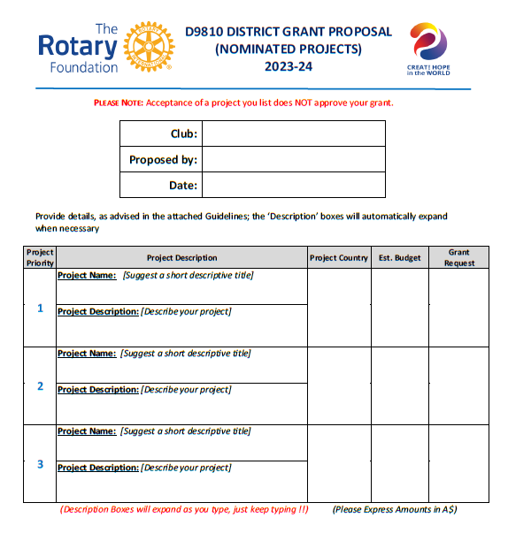
Lodgement Deadline:
24th June 2023

Slide 17
Prepare for Qualification
To apply for a District Grant your Club must be Qualified.
Club Qualification is renewed each Rotary year
Club Qualification requires:
1 Club Member to attend the Grants Qualification & Management Seminar, to be held, this year, online on 8th June. [Registration via TryBooking commences next week].
Lodgement of a signed Club MOU

Slide 18
Rotary Foundation Stewardship
Andrew Brownlie
(PP – Stewardship Chair)
Notes:
The aim of this session is to give you an awareness of what has to be done, and when, if you want to use funding from The Rotary Foundation to support your projects. We are NOT going to talk much about the planning and implementation of grant projects, - that is the role of the Grants Qualification & Management seminar that’s usually held in May. So this talk will cover the action needed to plan for and obtain grant funding for next Rotary year – and particularly for District Grants.
As you probably know, … [Click]

Slide 19
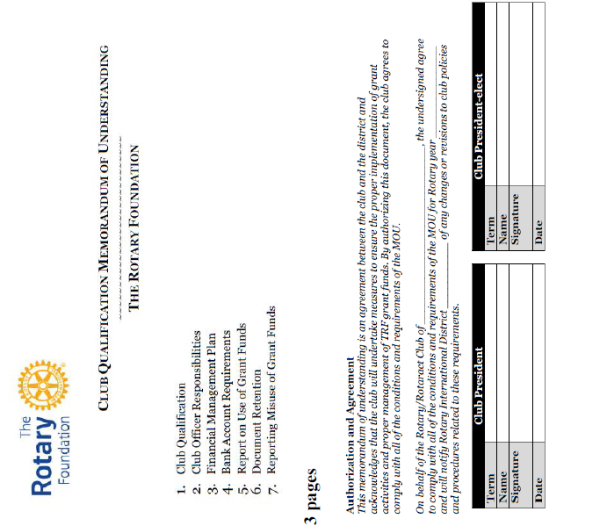
Read
Sign

Slide 20
Foundation Programs
David Alexander
(PDG – Foundation Chair)
Notes:
The aim of this session is to give you an awareness of what has to be done, and when, if you want to use funding from The Rotary Foundation to support your projects. We are NOT going to talk much about the planning and implementation of grant projects, - that is the role of the Grants Qualification & Management seminar that’s usually held in May. So this talk will cover the action needed to plan for and obtain grant funding for next Rotary year – and particularly for District Grants.
As you probably know, … [Click]

Slide 21
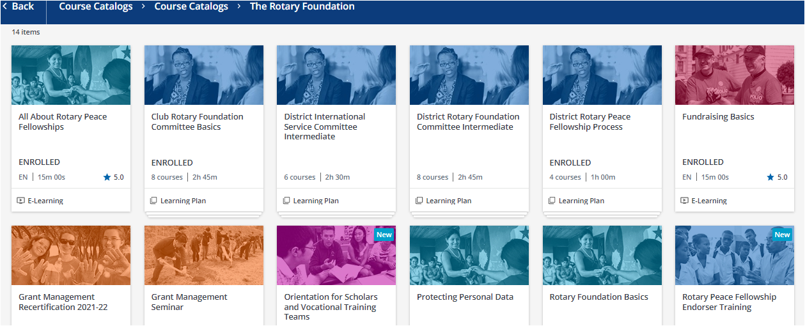
Foundation Learning Activities
Suggested Courses (Professional Development)
1. Rotary Areas of Focus
2. Club Foundation Committee Basics
3. Grant Management Certification
4. Grant Management Re-certification
5. Peace Fellowships

Slide 22
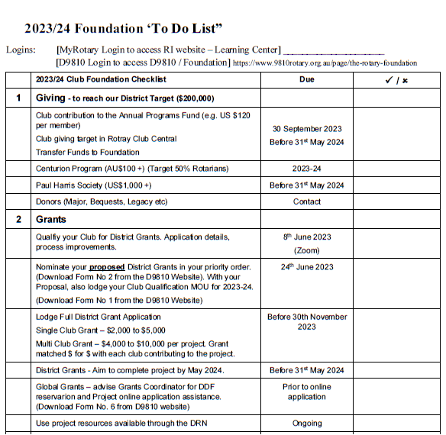
1 page
Guide
for 2023-24

Slide 23
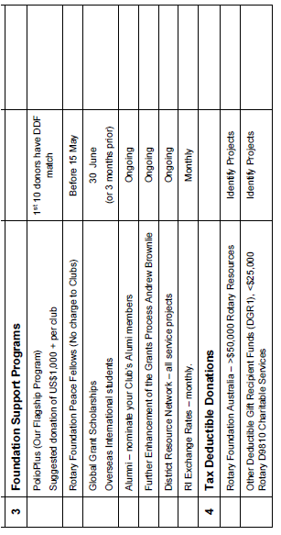
1 page
Guide
for 2023-24
Foundation
https://www.9810rotary.org.au/page/the-rotary-foundation

Slide 24
District Resource Network

Slide 25
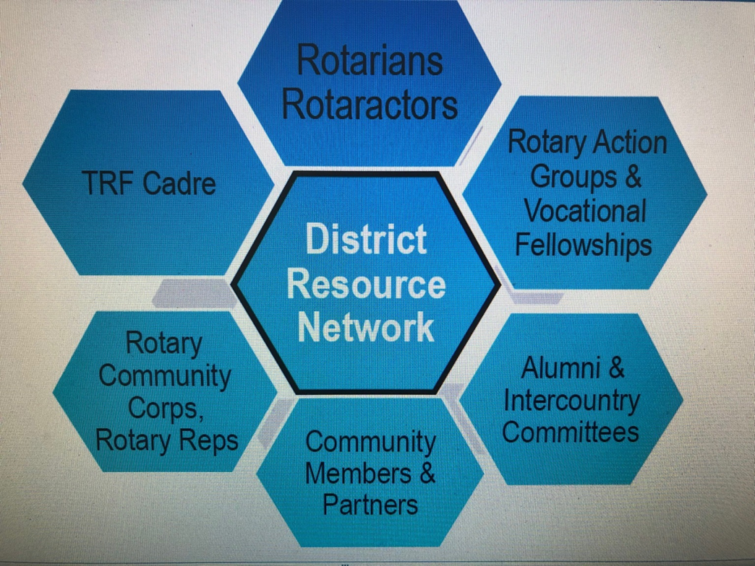
What is the District Resource Network (DRN)?
Notes:
I’d now like to spend a few minutes talking about the District Resource Network. How many of you are familiar with this?
As you know, Rotary has 7 Areas of Focus, and International Service has an application in each one of these.
Throughout the world, Rotary has District Resource Networks to connect clubs with the resources to design and improve their service projects and increase their quality, impact, and sustainability.
It comprises Areas of Focus, Project Planning and Grants Process experts from various sources, not all within Rotary, as shown on the schematic, that clubs can consult to improve a project or Foundation Grant proposal

Slide 26
How Can The District Resource Network Support Clubs?
Aligning a project or Grant with Rotary’s Areas of Focus.
Identifying local and international partner clubs and cooperating Organizations / NGOs.
Securing funding.
With the Global Grant process.
Project planning, design and implementation.
Continue to promote the resources and expertise it can offer.
Notes:
More specifically, here are some of the ways the DRN can assist you with project design, planning, funding and implementation.
And if the expertise you require is not yet available within the D9810 DRN, we maybe able to connect you with experts from other Districts who will be able to assist and / or with experts from the Cadre of technical advisers.
While satisfying the requirements of the Foundation for Global Grants can seem daunting, with the help of District and the DRN, it need not be so.

Slide 27
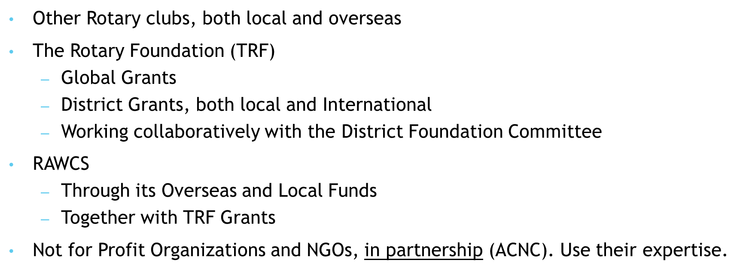
Collaboration through Partnerships
Notes:
As funds become harder to raise and access, collaboration becomes more important than ever. Working together to not only design and implement international projects, but also to fund them, including partnering on District as well as Global Grants
In addition to those shown on the screen; we are sure you have other avenues, but increasingly, pooling of resources will be more crucial.
And don’t overlook RAWCS - it also provides Clubs with an opportunity to conduct both local and overseas projects without the same stringent financial and administrative controls applied to The Rotary Foundation funded projects.
RAWCS projects can provide funding assistance to supplement Global Grant projects.
Partnering with NGOs can be another great resource, as they have the local knowledge and expertise on the ground in the difficult places for Rotarians to access or work in.

Slide 28
The Rotary Learning Centre
To access
Log into My Rotary: www.my.rotary.org
Select Learning Centre under Online Tools
Scroll through the Course Catalogue to find the courses you wish to take.
Recommend the Club Service Projects Committee Basics as a minimum.
Also available District International Service Committee Intermediate.
Rotary Showcase
Project Ideas
https://map.rotary.org/en/project/pages/project_showcase.aspx
Notes:
In addition to the “Foundation Learning Activities” on the Rotary Learning Centre that David has highlighted, there is also “Club Service Projects Committee Basics”, which is recommended for any club members undertaking this role for the first time.
In addition, there is a “District International Service Committee Intermediate” course which may be useful for members more experienced in the role.
There are many other useful and informative modules in the Learning Centre, with a comprehensive menu to enable you to search for your preferences.
And as mentioned before, the Rotary Showcase is a useful source of project ideas, as well as projects seeking partners or supporters.

Slide 29
The “4 Ps” of International Service
PROJECT
PROCESS
PASSION
PARTNERSHIP
Notes:
To summarise, I believe there are 4 things that are fundamental to successful International Service:
PROJECT – identify, scope, budget, conduct CNA
PROCESS - design and implement using the tools, resources and support available
PASSION – every project needs a champion to drive it forward.
PARTNERSHIP – collaborating with other organisations greatly increases the scope and impact of the project.

Slide 30
In Summary:
Resources
Tools To help clubs plan and deliver great projects
Partners
District
Key Dates:
Grants Qualification & Planning Seminar 8 June 2023
Foundation / International Seminar TBA August 2023
Notes:
So as you meet with your fellow Board members, please encourage them to plan and budget for a major international project or projects in 2023-24.
The world needs it and Rotary has the resources to help you.
Dates
Ian Ballantine comments??
Q & A

